Slide 1

Java Memory Model

Slide 2
Introduction
Java Virtual Machine(JVM) consumes some of the available space on host OS memory
This takes place in the RAM of the machine
Inside the JVM there are separate memory spaces
Heap
Non-Heap
Cache

Slide 3
Heap Memory
2 parts
New Generation
Old Generation
Heap is allocated when JVM starts up
Increases/decreases as the application is running

Slide 4
Young Generation
Contains newly allocated objects
3 parts
Eden Memory
2 Survivor Memories (S0, S1)
Most newly created objects go to Eden
When Eden is filled Minor GC is performed
Survivor objects are sent to one of the survivor memories
If there are objects in there, they get sent to the other survivor memory

Slide 5
Old Generation
Reserved for long lived objects that survive many Minor GCs
When Old Generation is full Major GC happens
Clears out the old unused objects

Slide 6
Non-Heap Memory
Includes Permanent Generation
Permanent Generation stores per class structures such as:
Runtime constant pool
Field and method data
Code for methods and constructors
Interned strings

Slide 7
Cache Memory
Includes Code Cache
Stores complied code from the JIT Complier
Stores Internal Structures
Loaded agent code and data
When the Code Cache is full it gets flushed
Objects aren’t relocated

Slide 8
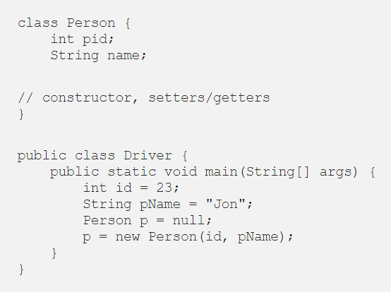
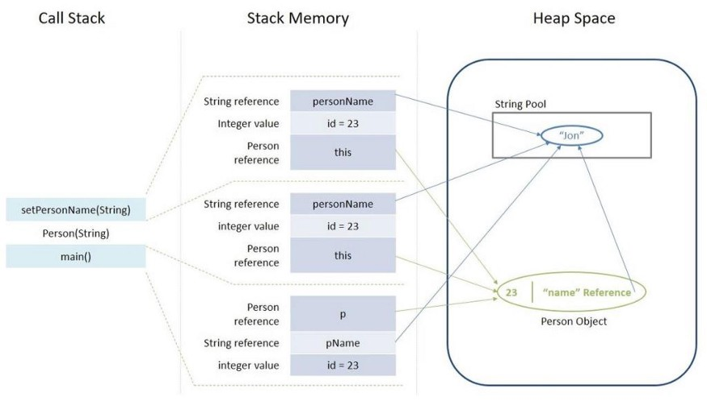
Java Stack
Stack Memory is used for execution of a thread
Contains method specific values and references to other objects in the Heap

